Slide 1


Feature Engineering: Unlocking the Power of Data
Welcome to the world of Feature Engineering, a critical component in the data science and machine learning pipeline. This presentation will dive deep into the art and science of crafting meaningful features from raw data, a process that can dramatically improve the performance of your machine learning models. We'll explore various techniques, from basic transformations to advanced methodologies, providing you with a comprehensive toolkit to enhance your data's predictive power.
Throughout this journey, we'll cover theoretical concepts and practical applications, ensuring you gain both knowledge and hands-on experience. Whether you're a seasoned data scientist or just starting your machine learning journey, this exploration of feature engineering will equip you with valuable skills to tackle real-world data challenges effectively.
by Dr. Tri Basuki Kurniawan

Slide 2

Defining Feature Engineering
Definition
Feature engineering is the process of using domain knowledge to extract features from raw data via data mining techniques. These features can be used to improve the performance of machine learning algorithms.
Importance
Well-engineered features can capture the underlying patterns in the data more effectively, leading to improved model performance, faster training times, and more interpretable results.
Skill Development
Mastering feature engineering requires a blend of domain expertise, statistical knowledge, and creative problem-solving skills. It's often considered both an art and a science in the field of data science.
Model Enhancement
Properly engineered features can sometimes make simple models perform as well as complex ones, reducing computational costs and improving model interpretability.

Slide 3

Types of Features: Numerical
1
Continuous Variables
2
Discrete Variables
3
Ratios and Rates
These are quantitative features that can take any value within a range. Examples include temperature, height, or stock prices. Continuous variables often require scaling or normalization to ensure consistent model performance.
These are numerical features with a finite set of possible values, often representing counts. Examples include the number of children in a family or the number of bedrooms in a house. These may be treated as categorical in some cases.
These are derived numerical features that represent relationships between other variables. Examples include body mass index (BMI) or conversion rates. These features can often capture complex relationships in a simple form.

Slide 4
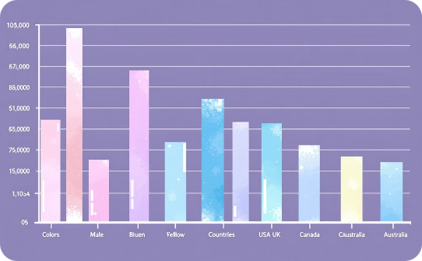


Types of Features: Categorical
Nominal Variables
Ordinal Variables
Binary Variables
These are categorical variables without any inherent order. Examples include color, gender, or country. Encoding techniques like one-hot encoding are often used to represent these variables numerically.
These categorical variables have a natural order or ranking. Examples include education level or customer satisfaction ratings. Techniques like ordinal encoding can be used to preserve the order information.
These are special categorical variables with only two possible values, often representing presence or absence of a characteristic. Examples include yes/no questions or pass/fail results. These can be easily encoded as 0 and 1.

Slide 5

Types of Features: Datetime
1
Timestamp Features
These represent specific points in time, including date and time information. They can be decomposed into
various components such as year, month, day, hour, minute, and second for more granular analysis.
2
Date Features
These focus on calendar dates without time information. They can be used to extract features like day of
the week, month, quarter, or year, which can reveal cyclical patterns in the data.
3
Time Features
These represent time of day without date
information. They can be useful for analyzing
patterns related to daily cycles or business
hours. Features like hour of day or time since
midnight can be extracted.
4
Duration Features
These represent time intervals or periods. They
can be calculated as the difference between
two date-time features and are useful for
capturing time-based relationships or event
durations in the data.

Slide 6





Feature Extraction Techniques
Domain Knowledge
Leveraging expert knowledge to identify relevant features that might not be immediately apparent in the raw data. This often involves collaboration with subject matter experts.
Statistical Methods
Using statistical techniques like correlation analysis, principal component analysis (PCA), or factor analysis to identify important features or create new composite features.
Text Analysis
Extracting features from text data using techniques like TF-IDF, word embeddings, or topic modeling to capture semantic information in a numerical format.
Image Processing
Extracting features from image data using techniques like edge detection, color histograms, or convolutional neural networks to capture visual information.

Slide 7



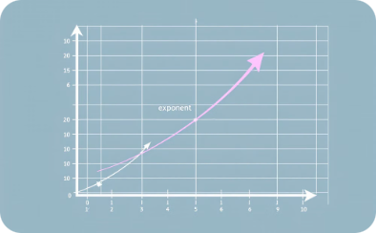
Feature Transformation Techniques
Scaling
Normalization
Log Transform
Power Transform
Adjusting the range of feature values to a common scale, such as 0 to 1 or -1 to 1. This includes techniques like min-max scaling and standardization (z-score normalization).
Adjusting values measured on different scales to a common scale, often to ensure that certain features don't dominate others. This includes techniques like L1 and L2 normalization.
Applying logarithmic functions to features to handle skewed distributions and reduce the impact of outliers. This is particularly useful for features with a wide range of values.
Using power functions to stabilize variance and make the data more normal distribution-like. This includes techniques like Box-Cox transformation and Yeo-Johnson transformation.

Slide 8

Creating Interaction Features
1
Multiplicative Interactions
Creating new features by multiplying two or more existing features. This can capture non-linear relationships between variables. For example, in a housing price model, multiplying square footage by number of bedrooms might create a meaningful interaction feature.
2
Additive Interactions
Combining features through addition or subtraction. This can be useful when the sum or difference of features is more informative than the individual features. For instance, in a financial model, the difference between income and expenses might be a valuable interaction feature.
3
Polynomial Interactions
Creating higher-order terms by raising features to powers or multiplying different powers of features. This can capture complex, non-linear relationships in the data. For example, in a physics model, the square of velocity might be an important interaction feature.

Slide 9
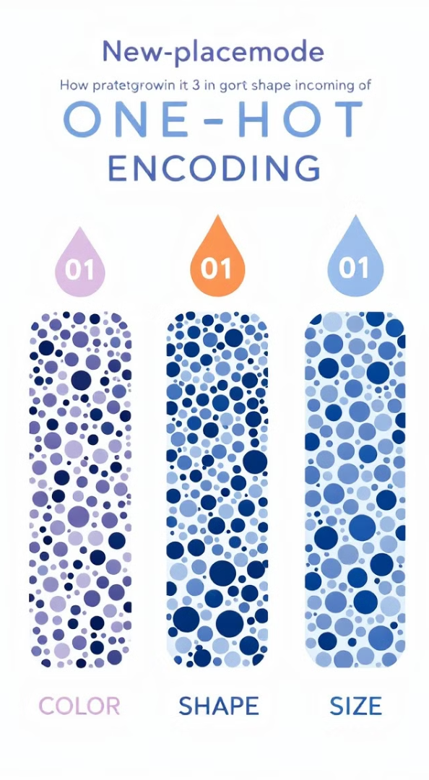
Encoding Categorical Variables: One-Hot Encoding
Category
Red
Blue
Green
Red
1
0
0
Blue
0
1
0
Green
0
0
1
One-hot encoding is a technique used to convert categorical variables into a format that can be provided to machine learning algorithms to improve predictions. In this method, each category value is converted into a new binary column. If a category has n possible values, n new columns are created. Each observation receives a 1 in the column for its corresponding category and 0 in all other columns.
This technique is particularly useful for nominal categorical variables where no ordinal relationship exists between the categories. However, it can lead to high dimensionality for categories with many unique values, potentially causing the "curse of dimensionality". In such cases, other encoding techniques might be more appropriate.

Slide 10

Encoding Categorical Variables:
Label Encoding
Process
Label encoding assigns a unique integer to each category. For example, 'Red' might be encoded as 0, 'Blue' as 1, and 'Green' as 2. This method is simple and doesn't increase the number of features.
Advantages
Label encoding is memory-efficient and works well with ordinal variables where there's a clear ordering of categories. It's also suitable for tree-based models that can handle numerical inputs well.
Considerations
The main drawback is that it imposes an ordinal relationship between categories, which may not always be appropriate. It can potentially mislead algorithms that assume higher numbers are more important.

Slide 11

Binning and Discretization
Divides the range of possible values into N bins of equal width. This method is simple but can be sensitive to outliers and may not capture the distribution of data effectively if it's skewed.
Creates bins that contain approximately the same number of observations. This approach is less sensitive to outliers but may create bins with very different widths.
Allows for the creation of bins based on domain knowledge or specific requirements of the problem. This can be particularly useful when certain value ranges have special significance.
Uses algorithms to determine optimal bin edges based on the data distribution. Methods like the Freedman-Diaconis rule or Sturges' formula can be used to suggest an appropriate number of bins.

Slide 12

Polynomial Features
Definition
Polynomial features are created by raising existing features to powers or multiplying features together. This technique can capture non-linear relationships in the data, potentially improving model performance for complex patterns.
Generation
For a set of features [a, b], polynomial features of degree 2 would include [1, a, b, a^2, ab, b^2]. The number of features grows rapidly with the degree, potentially leading to overfitting if not carefully managed.
Applications
Polynomial features are particularly useful in regression problems where the relationship between features and the target variable is suspected to be non-linear. They can transform simple linear models into more flexible non-linear models.
Considerations
While powerful, polynomial features can lead to overfitting, especially with high degrees. They also increase model complexity and computational requirements. Regularization techniques are often used in conjunction to mitigate these issues.

Slide 13





Real-World Dataset Exercise: Housing Price Prediction
Data Exploration
Begin by exploring the housing dataset, identifying key features such as square footage, number of bedrooms, location, and age of the house. Use visualization techniques to understand distributions and relationships between features.
Feature Engineering
Apply various feature engineering techniques. Create interaction features like price per square foot, encode categorical variables like neighborhood, and generate time-based features from the sale date. Consider polynomial features for non-linear relationships.
Model Building
Split the data into training and testing sets. Build multiple models using different feature sets, comparing their performance. Use techniques like cross-validation to ensure robust evaluation.
Evaluation and Iteration
Analyze model performance and feature importance. Iterate on your feature engineering process, refining existing features and potentially creating new ones based on insights gained from the initial models.

Slide 14

Group Discussions and Feedback
1
Share Insights
Encourage participants to share their approaches to feature engineering for the housing price prediction problem. Discuss innovative features that were created and their impact on model performance.
2
Compare Strategies
Compare different feature engineering strategies used by various groups. Analyze which techniques were most effective and why. Discuss any surprising findings or counterintuitive results.
3
Collaborative Problem-Solving
Work together to address challenges faced during the exercise. Brainstorm potential solutions and alternative approaches to difficult aspects of the feature engineering process.
4
Expert Feedback
Provide expert feedback on the approaches used, highlighting best practices and areas for improvement. Offer insights into how these techniques could be applied in real-world data science projects.

Slide 15



Conclusion: The Art and Science of Feature Engineering
Key Takeaways
Continuous Learning
Practice and Experimentation
Feature engineering is a crucial skill that combines domain knowledge, statistical understanding, and creativity. It can significantly improve model performance and provide valuable insights into the underlying data patterns.
The field of feature engineering is constantly evolving. Stay updated with new techniques, tools, and best practices. Engage with the data science community and share your own discoveries and innovations.
Mastering feature engineering requires hands-on practice. Continue to experiment with different techniques on various datasets. Remember that the effectiveness of features can vary greatly depending on the specific problem and dataset.

